Slide 1
NFL Penalties
Jun Hanvey

Slide 2
Topic
For this project, I am analyzing the effect of penalties on win probability in the NFL.

Slide 3
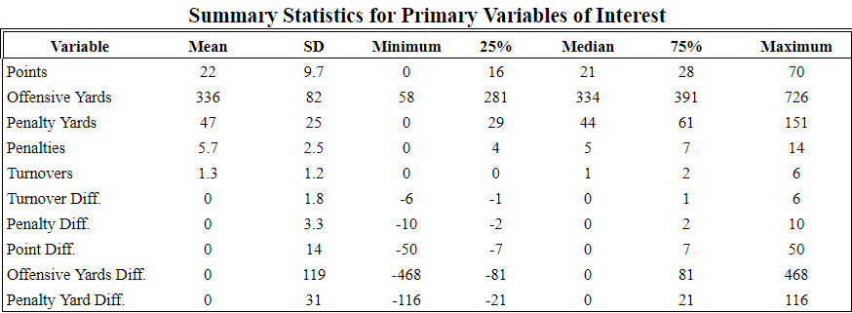
Summary Statistics

Slide 4
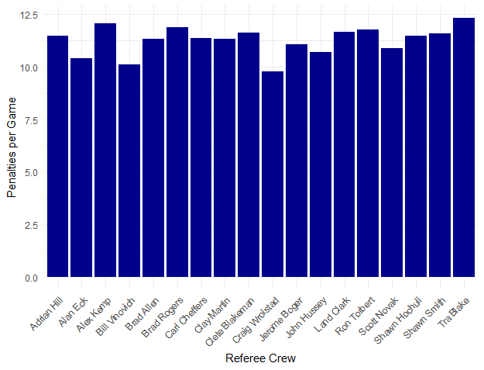
Penalties per Game by Ref Crew

Slide 5
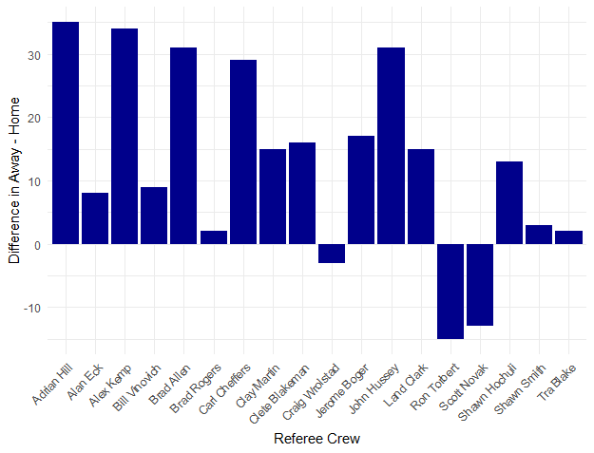
Away Penalties – Home Penalties by Referee Crew

Slide 6
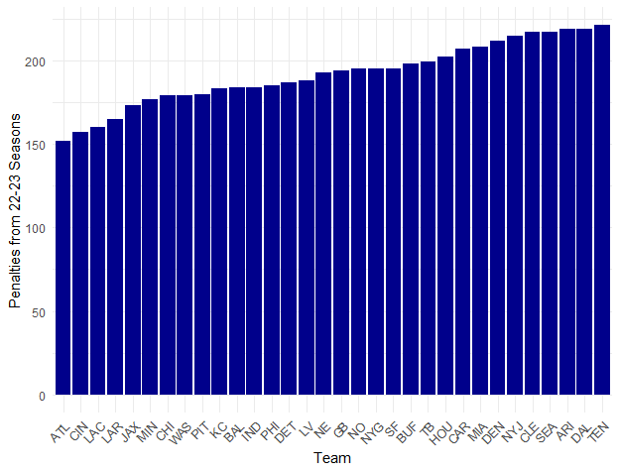
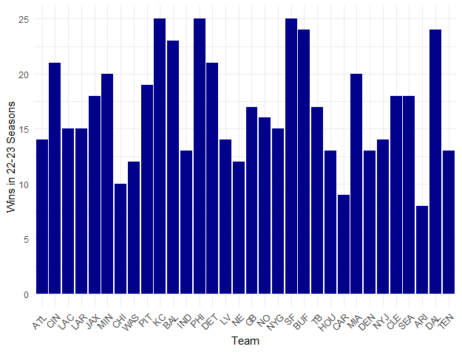
Early Exploration of Penalties and Wins
Least to Most Penalties by Team
Wins by Team

Slide 7
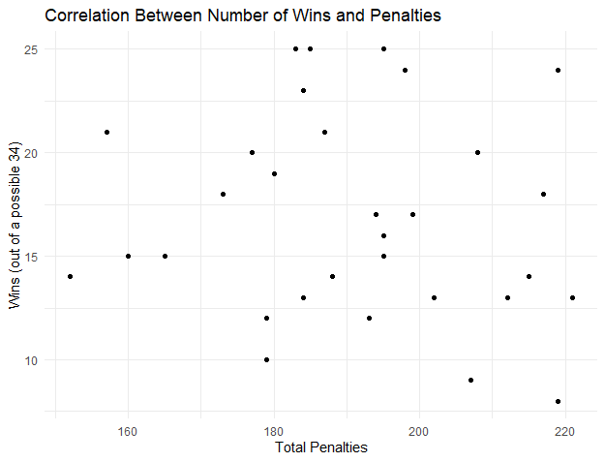
Wins and Penalties Correlation

Slide 8
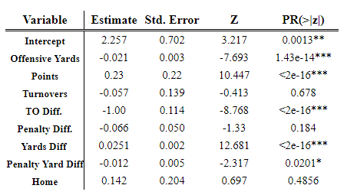

Model 1

Slide 9
Key Takeaways
Model predicts wins with 87.11% accuracy
Penalties do not seem to have a significant effect on win percentage
Both the preliminary plots and model support this theory
Multicollinearity seems like it might be a serious issue here.

Slide 10
Next Steps
Cross-Validation on testing data
Using crew as dummy variable
Look into potential interaction effects

